Slide 1
529 Data Analytics
October 25, 2016
Death Count Analysis
Chintan Shah
Yash Agrawal

Slide 2
Table of Content
Business Scenario
Business Objective
Selected Data
Processing Steps
Thinking Process
Variable Information
Exploratory Data Analysis Results
Regression Modeling Results
Conclusion

Slide 3
Business Scenario
Every year Centers for Disease Control and Prevention releases data about the mortality rate in United States of America. This release has all the factors covered that lead to the study of characteristics of those dying in the United States, to determine life expectancy and also to study the mortality trends.
This Death Count dataset covers death records of the U.S. for the year 2014. This information can be used to perform effective analysis to study the rise or fall in the death count as compared to the previous years. Also the cause of deaths occurring can be studied in order to take precautionary measures for prevention.
Stats show that, death count for the year 2012 is 2,543,279, with the population 314.1 million. In the year 2013 the death count is 2,596,993 with the population 316.5 million. The death rate here is a 2% rise from the previous year. Death count in 2014 is 2,626,418 with the population being 318.9 million. The death rate as compared to 2013 is a 1% rise. Thus with increase in population there has been a decrease in the death from 2012 to 2014.

Slide 4
Business Objective
To study average death age influenced by several location.
To study death count influenced by age and age group.
What is the likelihood death age influenced by several locations, Residential Institution, Sports and Athletics Area, Streets and Highway?
What is the probability of Natural Death count for Age Group 4 (60 years and above) as compared to all the other age groups?
What is the percentage of death count for Resident Status Foreign Residents and Age Group 3(41-60 years) as compared to other Resident Status’s and Age groups?

Slide 5
Selected Data
File Name: DeathRecords.csv .
Source Of Data: https://www.kaggle.com/cdc/mortality/version/1 .
Total Number of Rows: 2,626,418.
Total Number Of Variables: 38.
Time Period: 2014.

Slide 6
Variable Information
 | Predictor Variable | Response Variable
Categorical Data | DayOfWeekofDeath
 | PlaceOfInjury
 | MannerOfDeath
 | ResidentStatus
 | MonthOfDeath
 |  | AgeGroup
Continuous Data |  | Age

Slide 7
Processing Steps
Age is given as a continuous data and thus it has been divided into four bins and converted to categorical data. The bins are as follows,
0-20 years: Bin 1.
21-40 years: Bin 2.
41-60 years: Bin 3.
61 years and above: Bin 4.

Slide 8
Thinking Process
As mentioned in the previous slide there are 38 variables in the dataset. Out of these 38 variables, 7 variables were used in order to satisfy the Business Objective stated in slide 2.
Histogram is used to determine Average Age of death influenced by Place of Injury. This is done to obtain an association between the variables chosen.
Histogram is used to determine Death Count for Age Group and Natural Death. This is done to obtain an association between the variables chosen. Also a Chi-square test is performed to verify the same.
A SGPLOT is plot to determine change in Mean values for Resident Status with Age.
A SGPLOT is plot to determine change in Mean Values for Day of death and Age.
A SGPLOT is plot to determine change in Mean Values for Month of Death and Age.

Slide 9
Thinking Process Continued
Place of Injury has been used as a predictor variable to carry out Generalized Linear Modeling. This will give an idea about which location has more number of death counts with respect to Age as the response variable.
Resident Status has been used as a predictor variable to carry out Logistic Regression . This model is used to come to a conclusion where death count for a particular Resident Status is taken for a particular Age Group.
Manner of Death has been used as a predictor variable to carry out Logistic Regression. This model is used to come to a conclusion where death count for a particular Age Group is taken with a particular month as a reference.
These variables satisfy the test of association and thus are used to carry out exploratory and regression analysis.
Other variables are not used as most of them are flag values, and a few of them do not give a good association.

Slide 10
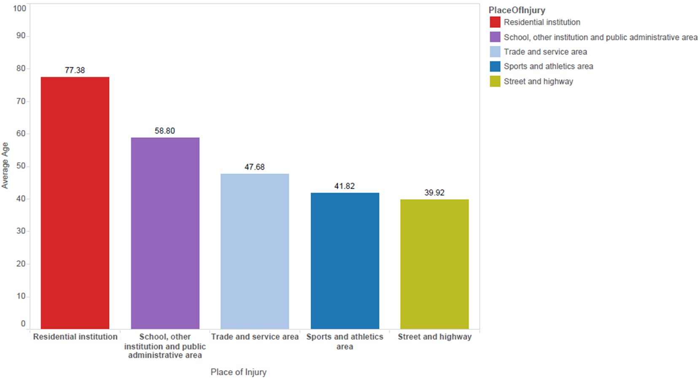
Exploratory Data Analysis 1
To determine Average Age of death influenced by Place of Injury.
We infer that the average death age of people goes on increasing with location involving more mobile crowd as compared to less mobile crowd.

Slide 11
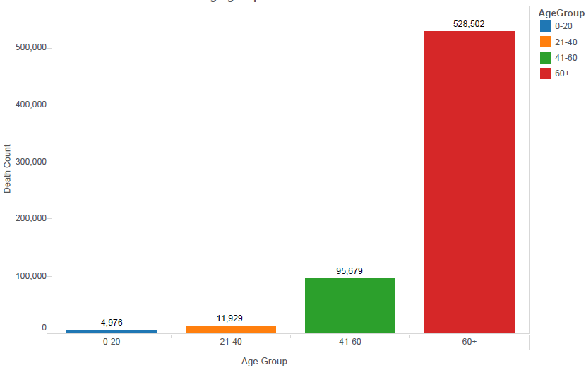
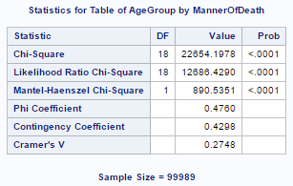
Exploratory Data Analysis 2
To determine Death Count for Age Group and Natural Death.
We can infer that with increase in Age, the death count with Natural Death also increases thus showing some association.
This can also be verified using, the chi-square test.
This test gives a good chi-square with p-value less than 0.05 which states that there is a good association.

Slide 12
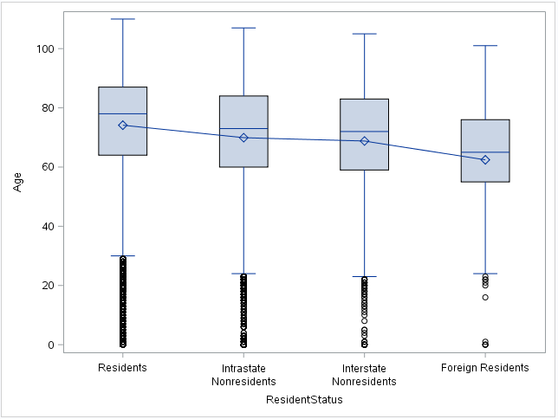
Exploratory Analysis 3:
To determine change in Mean values for Resident Status with Age.
This plot shows change in the mean values of the four Resident Status’s against Age.
An inference can be made that the Resident Status
Resident Status ( Categorical Predictor Variable) and Age ( Continuous Response Variable ) show some association.

Slide 13
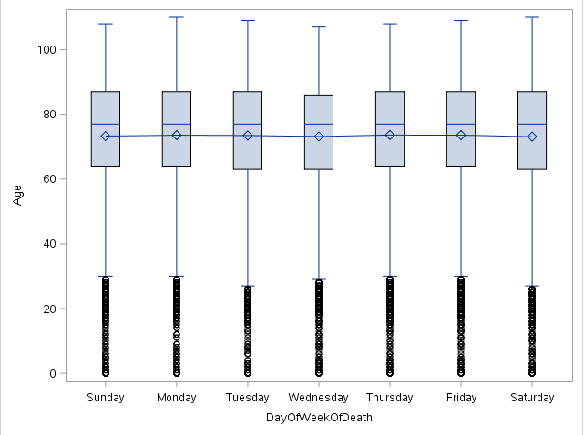
Exploratory Analysis 4
To determine change in Mean Values for Day of death and Age.
In this analysis we see that, the mean values do not vary considerably with respect to Age and thus it does not give a strong association.
Thus these predictor and response combination is not considered for modeling.

Slide 14
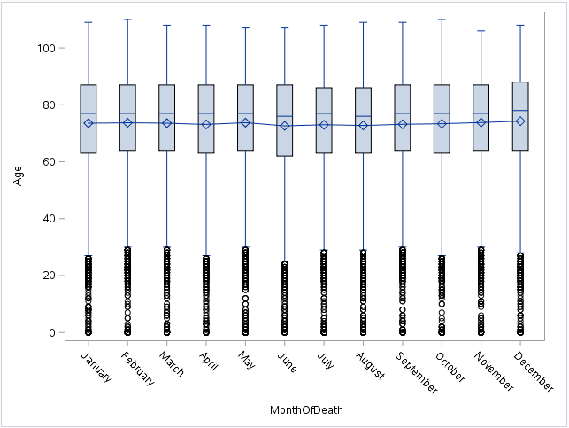
Exploratory Analysis 5
To determine change in Mean Values for Month of Death and Age.
In this analysis we see that, the mean values do not vary considerably with respect to Age and thus it does not give a strong association.
Thus, the predictor and response combination is not considered for modeling.

Slide 15
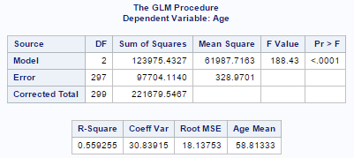
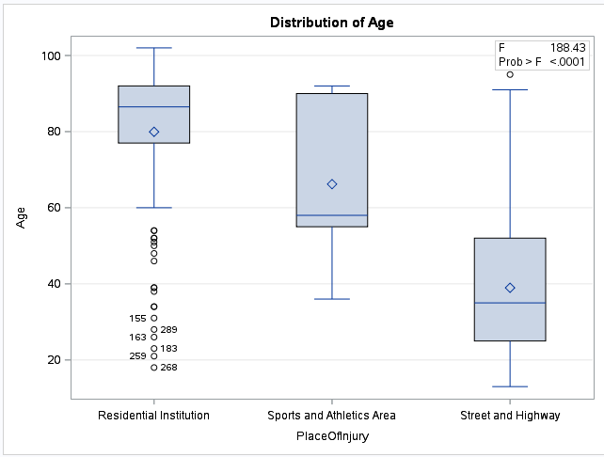
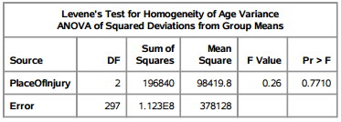
Regression Model 1
What is the likelihood death age influenced by several locations, Residential Institution, Sports and Athletics Area, Streets and Highway?
This regression model satisfies the criteria for the model to be a good fit.
The likelihood average death age various from location to location.

Slide 16
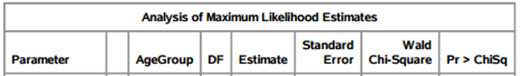
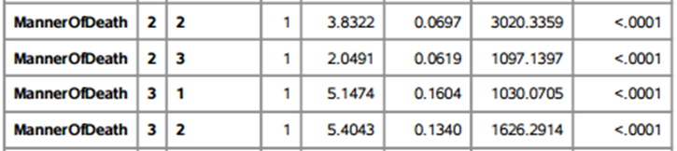
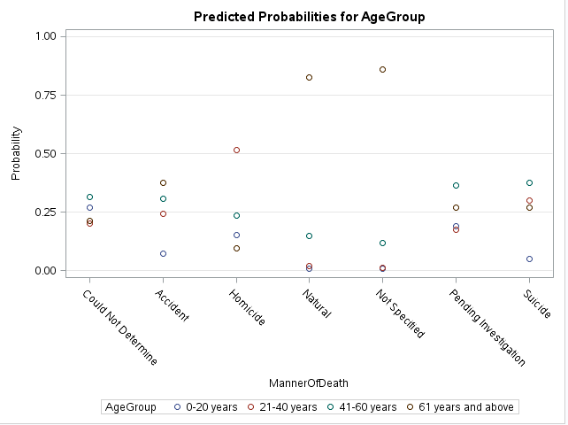
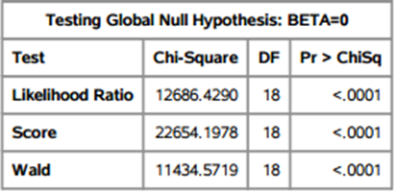
Regression Model 2
What is the probability of Natural Death count for Age Group 4 (60 years and above) as compared to all the other age groups?
The probability of death under the Not Specified category is most but has a negative likelihood estimate.
Implementation of this model leads us to the inference that, probability of Natural Death on age group 60 years and above is the most.

Slide 17
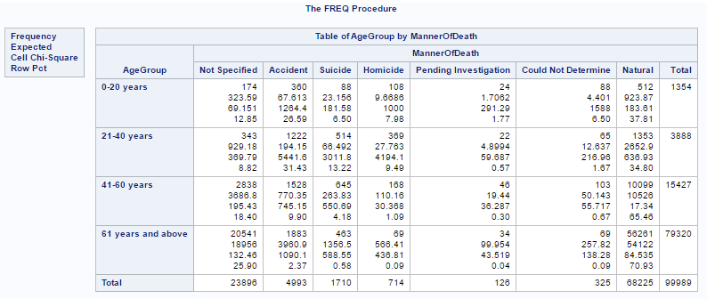
Regression Model 2 continued
This is a frequency graph to verify the results of logistic regression.

Slide 18
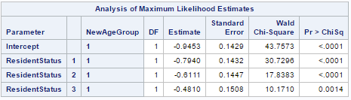
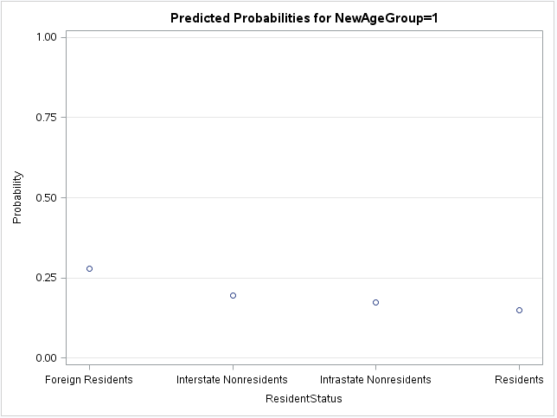
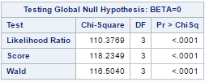
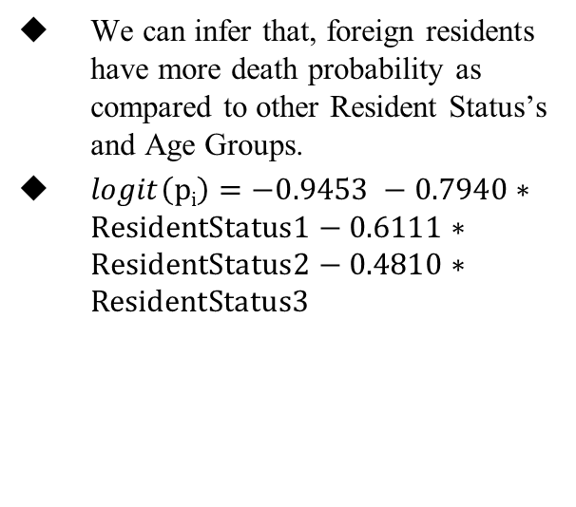
Regression Model 3
What is the percentage of death count for Resident Status, Foreign Residents and Age Group 3(41-60 years) as compared to other Resident Status’s and Age groups?
We can infer that, foreign residents have more death probability as compared to other Resident Status’s and Age Groups.
$logit\left(pi\right)=−0.9453 −0.7940∗ResidentStatus1−0.6111∗ResidentStatus2−0.4810∗ResidentStatus3$

Slide 19
Conclusion
Several regression models have been implemented along with exploratory to give different analysis indicating the different causes of death and also the different age groups in which people have died.
The 1st exploratory analysis shows that the average death age for the chosen five locations ranges from approximately 40 years to 78 years.
The value of Natural Death count for Age Group 4 (60 years and above) is 528,502.
The third exploratory analysis states that Resident population is the most for all the age groups.
The R-square being 56% tells us that, the average death age at a Residential Institution is 78 years, for Sports and Athletics Area is 65 years and for Streets and Highway is 40 years.
The multi-nominal regression output states that, more than 75% of people in Age Group 4 (60 years and above) have a Natural Death. This count is 56,261.
The multi-nominal regression output states that, more than 25% of Foreign Residents are likely to die as compared to other Resident Status’s.

